Slide 1
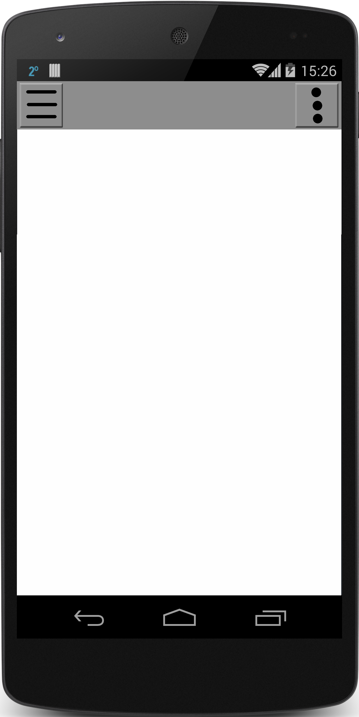
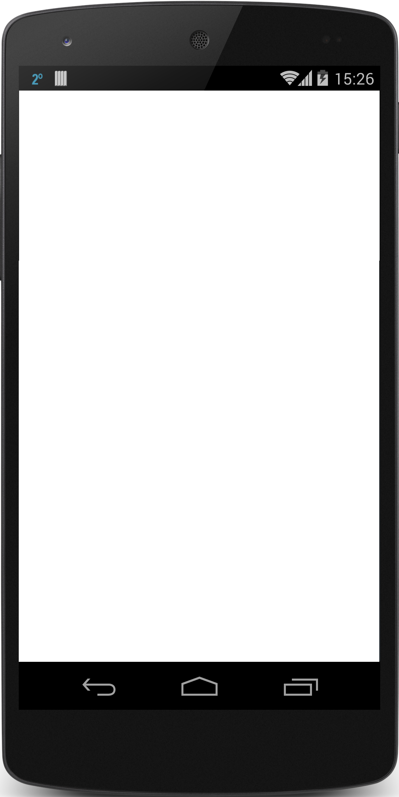

Notes:
TEMPLATES

Slide 2
Login Page
Username
Password
LOGIN
Facebook
Google
Register
Forgot Password

Slide 3
Register Page
Username
First Name
Last Name
Email
Phone Number
Zip-Code
Password
Confirm Password
Accept User Agreement
Register
Cancel
Notes:
Need to check against existing usernames

Slide 4
Reset
Password
Page
Password Reset
*Enter Email Phone Number Or Username
Submit
Cancel
Notes:
Can throw an error under the text field if the user doesn’t exist
Will parse automatically the texts inputted

Slide 5
Change
Password
Page
Password Change
Verification Code
New Password
Confirm Password
Submit
Cancel
Notes:
Can throw an error under the text field if the user doesn’t exist
Will parse automatically the texts inputted

Slide 6
Change Password Page
Verification Code
New Password
Confirm Password
Go
Notes:
Get either a text message a email

Slide 7
Home Page
-map
-list
Nav Bar
Settings
Nav Bar
Settings
Map
List
Map
List
Map W/ Pins
Search Bar
Details
# of Results
V
Filter
Title
Place
# of players/ total
Distance
+

Slide 8
Home Page
Game
Title
Nav Bar
Settings
Start/end time
Game Captain
Location
# of players/ total
Description
Pop up (“joined”)
Button changes to
”Leave Game”
Name | # Event | Rating | #Played
JOIN GAME
Message here
>
Notes:
Add list of items to bring button (checklist of game items)

Slide 9
Profile Page
Nav Bar
Settings
Profile
Picture
Name
Age:
Location:
message
Gender:
Rating:
Last Active:
Achievments
<
>
Past games

